Slide 1
Node Js

Slide 2
What actually is node js is
A platform which allows us to run JS on a computer/server
Read, Create, delete and update files
Easily communicate with a database
It is an open source, cross-platform runtime environment for developing server-side and networking applications
It is written in JavaScript.

Slide 3
Why node.js is so popular
It uses JS
Very fast (Runs on the v8 engine & use non-blocking code)
Huge Ecosystem of open source packages (npm)
Great for real time service
Single threaded

Slide 4
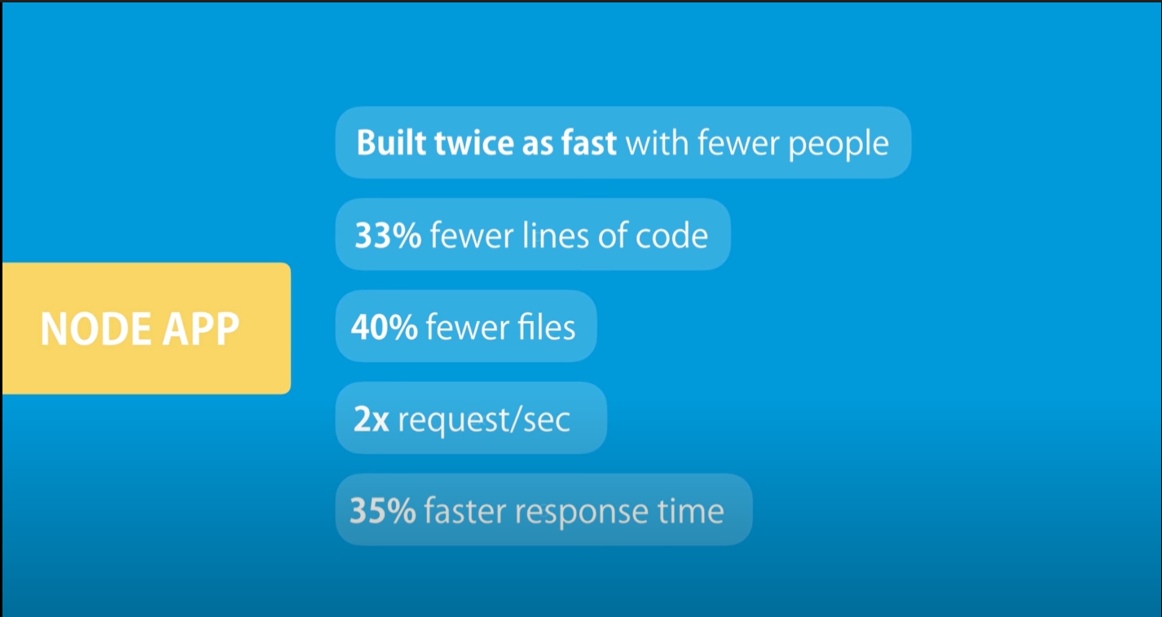
Vs Java

Slide 5
Javascript engine:
Computers do not understand JS
A js engine Takes JS and convert it into something it does understand which is basically – MACHINE CODE

Slide 6
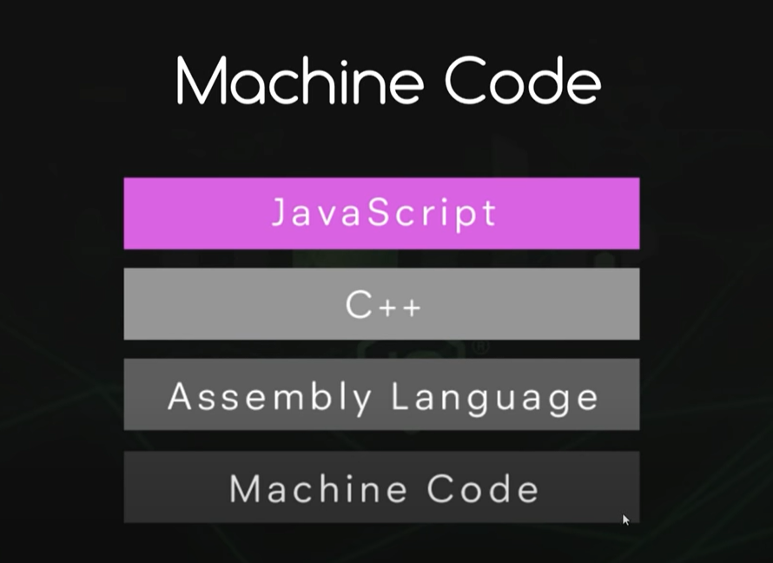

Slide 7
V8 engine links
Site: https://opensource.google/projects/v8
Github: https://github.com/v8/v8

Slide 8
Difference
JS is Synchronous in nature
Node is asynchronous in nature

Slide 9
Let’s Do Some hands On
Install node js and get started

